Slide 1
INTRODUCTION TO
IT SERVICE MANAGEMENT

Slide 2
IT Service Management Objectives
ITIL is a Best Practice Framework used …..
To align IT services with the current and future needs of the business and its Customers
To develop the quality of the IT services delivered
To reduce the long term cost of service provision
Notes:
Align Business Needs
Improve Quality
Reduce Costs

Slide 3
Why Service Management
Increasing IT visibility and Reliance
Increasing demand from Business to deliver effective IT solutions/services (Cost Effective)
Increasing complexity of IT infrastructure and processes
Increasing competition
Increasing pressure to realise return on investment

Slide 4
Considerations
Do not be over ambitious
Consider what elements already exist, are in use and effective
Identify what can be re-used or needs to be developed
Adapt the guidelines to meet your requirements

Slide 5
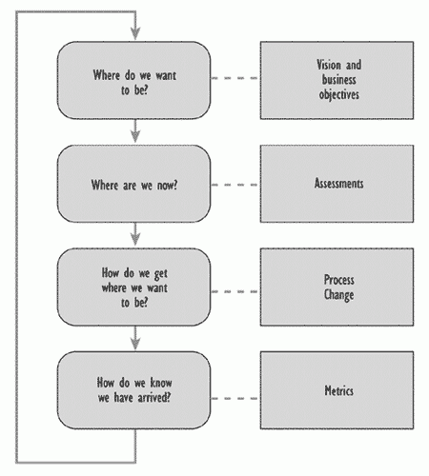
Process Improvement Model

Slide 6
Process Improvement Stages
Process improvement definition
Communication
Planning
Implementation
Review and Audit
Notes:
Page 9 Handbook

Slide 7
ITIL Service Management
Service Support
  Day to day operational support of IT services
Service Delivery
  Long term planning and improvement of IT service provision
Key Definitions
Customer: recipient of a service: usually the Customer management has responsibility for the funding of the service.
Provider: the unit responsible for the provision of IT service.
Supplier: a third party responsible for supplying or supporting underpinning elements of the IT service.
User: the person using the service on a daily basis.
Notes:
Service Support Day to Day Function that Supports the Service Delivery Processes

Slide 8
IT Service Management Overview
SPOC Single Point of Contact
SD Service Desk
IM Incident Mngt
CH Change Mngt
REL Release Mngt
SLA Service Level Agreement
SLM Service Level Mngt
AM Availability Mngt
CM Capacity Mngt
IT SCM IT Service Continuity Mngt
BUSINESS (Customer)
User
User
User
SLA
SPOC
SLM
SD
AM
CM
SERVICE
SUPPORT
SERVICE
DELIVERY
IM
IT SCM
PROBLEM
FINANCE
CH
REL
CONFIGURATION

Slide 9
Service Support Process Model
Business, Customers or Users
Difficulties
Queries
Enquiries
Communications
Updates
Workarounds
Management Tools
Incidents
Incidents
Service Desk
Changes
Releases
Incident Management
Problem Management
Change Management
Release Management
Configuration Management
C M D B
Incidents
Problems
Known Errors
CI’s
Relationships
Changes
Releases

Slide 10
Service Delivery Process Model
Business, Customers and Users
Availability
Management
Queries
Enquiries
Communications
Updates Reports
Availability Plan
Design Criteria
Targets/Thresholds
Reports
Audit Reports
Service Level
Management
SLA’s, SLR’s, OLA’s
Service Reports
Service Catalogue
SIP
Exception Reports
Audit Reports
Capacity
Management
Requirements
Targets
Achievements
Capacity Plan
CDB
Targets/Thresholds
Capacity Reports
Schedules
Audit Reports
Financial Management
for IT Services
IT Service Continuity
Management
Alerts & Exceptions
Changes
Financial Plan
Types & Models
Costs & Charges
Reports
Budgets & Forecasts
Audit Report
IT Continuity Plans
BIA & Risk Analysis
Control Centres
DR Contacts
Reports
Audit Reports
Management
Tools

